Slide 1
Casual Labour Job Finder
Agenda : Release 2
Date : 26-04-2023
Team Members :
Aditya Acharya
Amey Choudhary
Sai Nikhita Obbineni

Slide 2
Table of Contents
Motivation
Objectives
Project Modules
Development Environment
Milestones

Slide 3
Motivation
Most online job portals cater to white collar jobs. The few that cater to blue collar jobs suffer from either of these or some combination of these issues -
Too technologically complex for the average blue collar worker to understand and use effectively
available only in major languages like English.
For employers looking to hire local semi-skilled blue collar workers, it is extremely tedious and difficult for them to get interested blue collar workers
Objective
Simplify the process of job search for both job seekers and employers by
providing a toll-free number for job seekers to enquire about current vacancies in their vernacular and
allowing job posters to post current vacancies available

Slide 4
Objectives
The primary objective of the Casual Labour Job Finder is to provide an accessible platform for blue-collar job seekers to find suitable employment opportunities, and for employers to hire semi-skilled blue-collar workers without much hassle.
To create a job portal that is user-friendly and easy to use for blue-collar job posters
To overcome the language barrier by providing a toll-free number for job seekers to enquire about job vacancies in their vernacular
To simplify the process of job posting for employers seeking to hire blue-collar workers
To improve the overall employment rate among blue-collar workers by providing access to better job opportunities

Slide 5
Rescoping for R2
Our project involved building a phone number pipeline, which the user can interact with. For this, we required an IVR, which is a licensed software.
Due to various delays from the client side, the client was unable to provide us with the required IVR.
Because of this, the client asked us to make a minimalistic UI app pipeline instead of the originally intended IVR pipeline.
We have thus, made a UI app integrated with the pipeline, which suffices the client’s need and is the alternative till we are provided with the licensed IVR

Slide 6
Timeline
Duration | Task
25-01-23 to 08-02-23 | Project Concept & Understanding
09-02-2023 to 22-02-23 | UI Screens & User Stories
23-02-23 to 09-03-23 | UI Screens & Database Schema
10-03-23 to 30-03-23 | User Research & Frontend Development
31-03-23 - EOP | Backend & Vernacular Pipeline

Slide 7
Milestones
Milestone | Release Schedule | Status | Deliverable
User Stories & UI Screens | R1 | Completed | YES
Job & User Management | R1 | Completed | YES
Vernacular Pipeline | R2 | Completed | YES
Customer Support | R2 | Incomplete | YES

Slide 8
Completed and Pending Tasks
Serial Number | Task | Sprint Number | Status
1 | Job Poster Registration | 4 | Completed
2 | Posting a New Job | 4 | Completed
3 | Job Poster Login | 4 | Completed
4 | Manage Account | 4 | Completed
5 | Job Seeker Contact for Job | 4 | Pending
6 | Manage Previously Posted Jobs | 5 | Completed

Slide 9
Continued
Serial Number | Task | Sprint Number | Status
7 | Manage Job Responses | 5 | Completed
8 | Vernacular Call Audio Interact | 6 | Pending
9 | Vernacular English Translation | 6 | Completed
10 | English Machine Query Translation | 7 | Completed
11 | Query Processing | 7 | Completed
12 | Response Recording | 7 | Pending

Slide 10
Continued
Serial Number | Task | Sprint Number | Status
13 | Job Seeker Feedback | 8 | Pending
14 | Job Poster Feedback | 8 | Pending

Slide 11
Progress Made From R1
Frontend:
Frontend made more responsive.
Frontend UI made more appealing.
Frontend changed with respect to backend(writing queries and displaying results)
Backend:
Made the backend for signup and login
Made the backend for posting a new job
Made the backend for displaying job
Made the backend for editing job
Made the backend for viewing responses
Made the backend for editing profile

Slide 12
Continued
3. Pipeline:
Made python file, which uses client API to automatically recognise speech and convert to text
Made python file, which uses client API to translate from 1 language to another
Made python file, which uses client API to read the text into speech
Made the python file, which uses the all the above for processing a vernacular query and returning its output
Made a minimalistic UI app to integrate and run pipeline

Slide 13
Continued
4. Discarded Work
Made nodeJS file, which could convert speech to text. Had to be discarded because of faulty api and changed to python because of lack of documentation.
Made nodeJS file, which could convert text to speech. Had to be discarded because of faulty api and changed to python because of lack of documentation.
Made python file, which could generate url of audio file by uploading them to s3. Had to be discarded as free s3 such as play.min.io turned out to be unreliable.

Slide 14
Development Environment / Tech Stack
For Design:
Figma : The team uses Figma for designing and collaborating on designs. It is also used to visualise the website.
For Development:
Development Environment:
Visual Studio Code : The team uses Microsoft’s Visual Studio Code as anIDE.
Programming Languages / Frameworks / Dev Tools:
React : For frontend development of website.
Nodejs: For backend development of website.
HTML: For basic substitute UI app.
Python : For pipelining
minIO: For storage and extraction of url of audio files
MongoDB: For the database of website.
GraphQL: Backend.
Version Control:
Version Control System : The team uses ‘git’ as a version control system.
For Documentation:
Google Docs : The team uses Google Documents for documentation and collaboration on documents
For Repository:
GitLab: The team uses GitLab as a repository for the code and documentation of the project.

Slide 15
User Research
Mr Debanjan Ghoshal
- Kadamba Mess Manager (Job Poster)
(Did not prefer to have his photo clicked)
Discussion points :
The UI needs to be a bit more descriptive. Most names of options were a little bit ambiguous and required a little bit of explanation to understand. Also use simpler terms
Job deletion and job completion are two separate actions. Job deletion includes deleting the job both from the user’s account as well as the database. Job completion includes deletion of the job from the user’s account but not from the database (It indicates all vacancies were successfully fulfilled)
A salary range / value field is needed in the job details
The user had a little difficulty navigating through the website. We had to explain a few points.
Jobs that are permanent v/s temporary are 2 different kinds and would require slightly different details.
The website needs to be a little more interactive & lively.
There might arise a need for multiple locations for a single job.
A branding page is required so ensure trust in the website.
Introduce a field called role. This would be separate from tags
Even if something of this sort gets launched, how will job seekers get to know about the toll-free-number

Slide 16
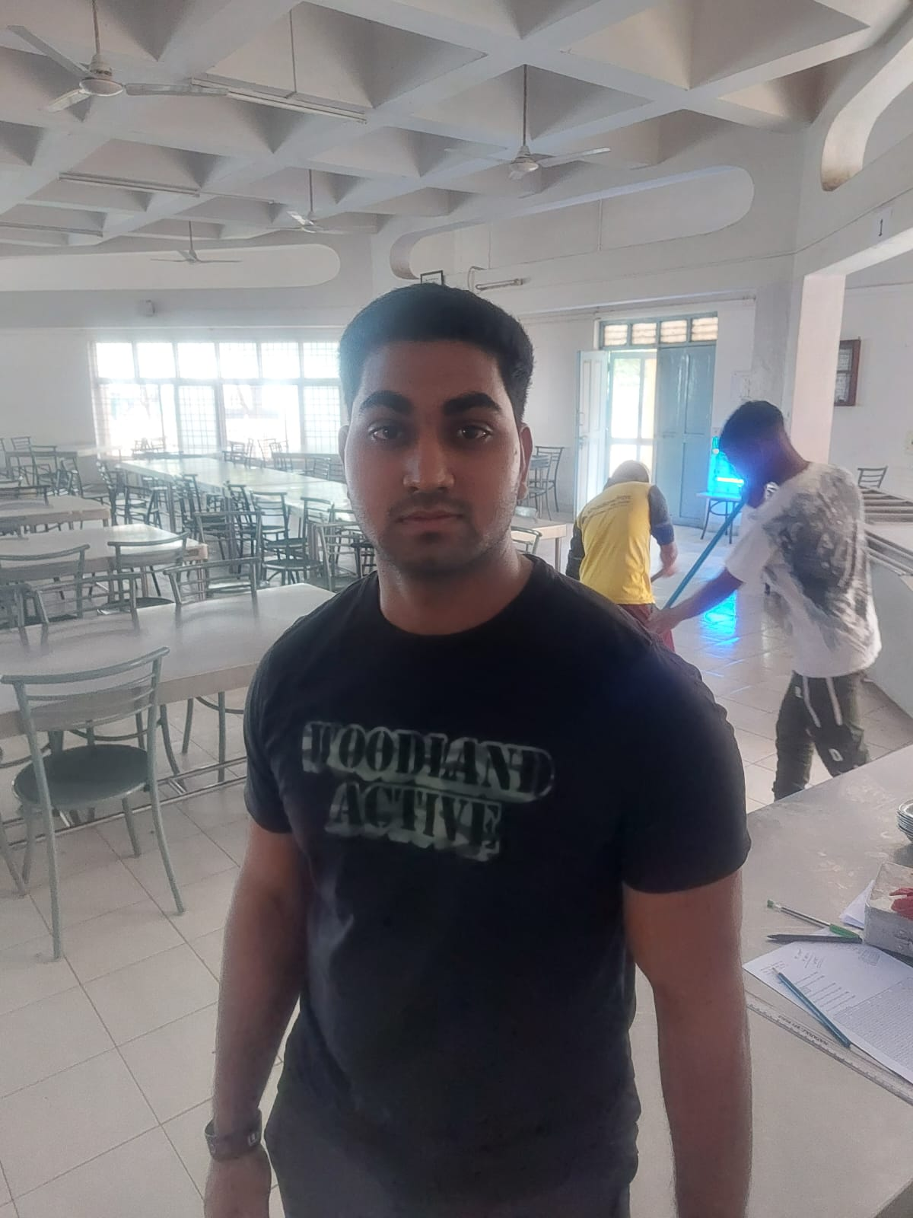
User Research
Mr Krishna Thakur
- Works at Kadamba Mess (Job Seeker)
Discussion Points :
The main things that should get clarified before one would make a choice should be salary, daily work duration and location
If its a multi-person job i.e if it requires interacting with other people, they also should preferably know a common language
Even if something of this sort gets launched, how will people like us come to know about the toll-free-number

Slide 17
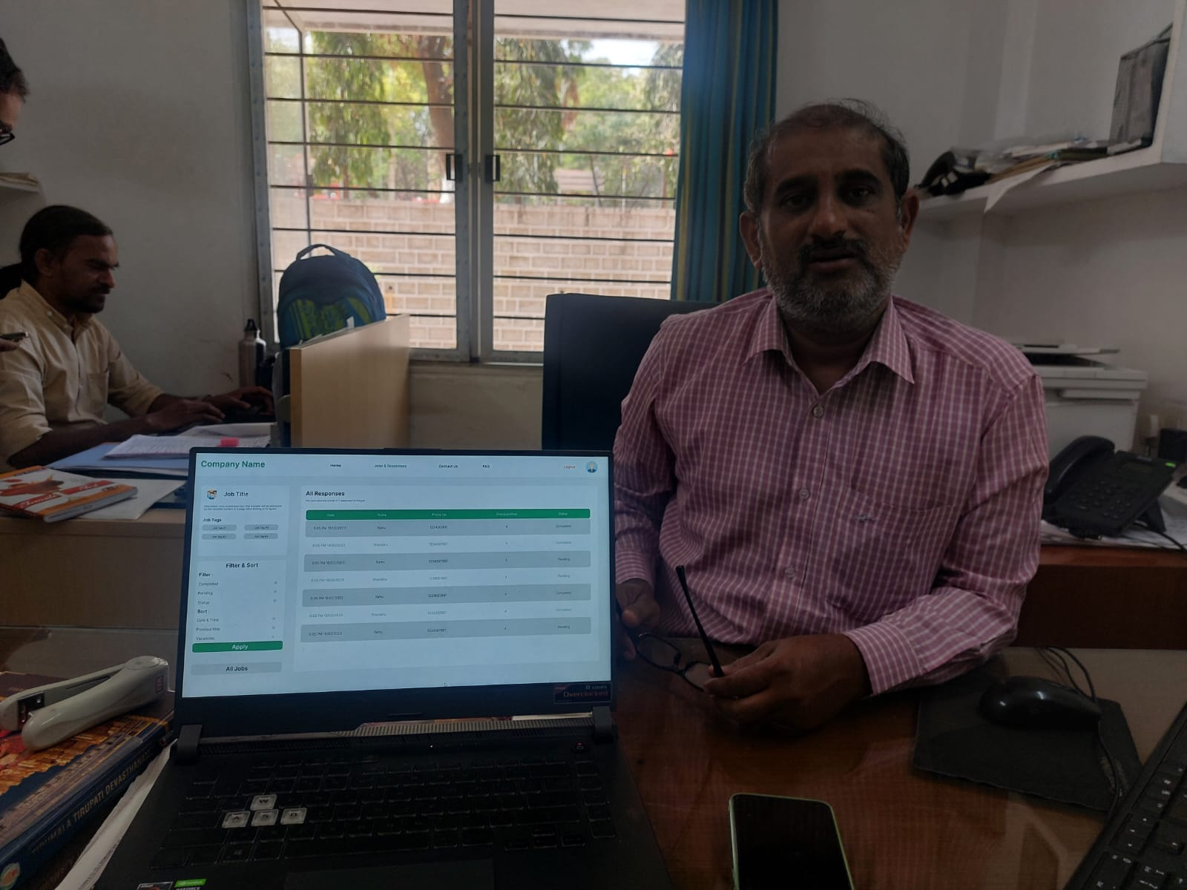
User Research
Mr Krishna Kishore
- Hostel Manager Bakul (Job Poster)
Discussion points :
Each job seeker that shows interest should have a unique id associated with him/her. Makes it easier to search him/her.
The job seeker details should be a little more in depth. Eg : field of experience of the job seeker, location etc.

Slide 18
User Research
Anonymous
- Cleans washrooms at Bakul (Job Seeker)
(Preferred not to be named nor have a picture clicked)
Discussion Points :
If the job includes something that we currently do not know, the skill can be easily learnt and then they can work.
They directly do not deal with the jobs, their supervisor tells them about the vacancies

Slide 19
User Research
Rajamani (Security Parijat)
(Job Seeker)
Video Link : https://drive.google.com/file/d/1nDJX8aPYyaayb8vnzxQst7VeIKMbd02D/view?usp=share_link
Video Points :
We generally call or directly meet with Sir/Ma’am, discuss without fail the number of days, daily wage, daily hours & timings and how many other people will work with me.
The product seems beneficial since it is helping us find new jobs.
Newspapers are generally our source for finding new jobs

Slide 20
Challenges faced in project:
Lack of proper resources
Lack of good APIs: The APIs provided were faulty and unreliable. Their accuracy was bad and would give an error on the same code. The server would fail.
Lack of IVR: Initially, an IVR, which is essential for toll-contact, was to be provided. But it still hasn’t been provided by the client. We had to switch to UI app at the end as an alternative.
Lack of s3: free s3 are unreliable. A good, licensed s3 wasn’t provided by the client.
Lack of documentation: There was a lack of documentation of the resources which were provided even. We had to contact them several times, thus slowing down the process.

Slide 21
Continued
2. Lack of work force: We lacked a team member, which demanded more workload.
3. New Technologies: We had to use graphQL for backend, undocumented external APIs, minIO, IVR .etc. which took some time getting accustomed to.
4. Merging Conflicts: Due to various changes by different users, we faced difficulty in merging changes.
5. Discarding Work: We often had to discard work, which lead to loss of time and effort. The reasons were mostly lack of communication between client and team and unreliable technologies.

Slide 22
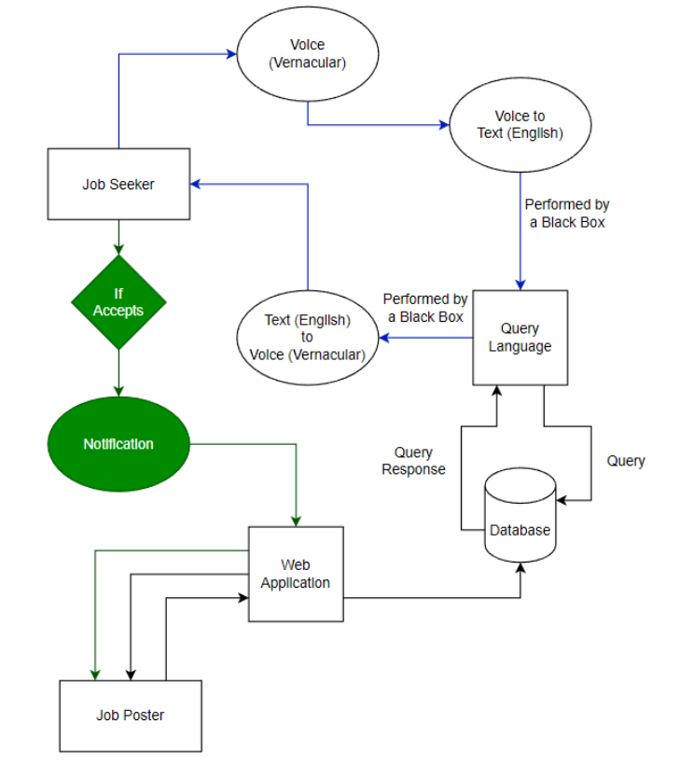
Project Concept

Slide 23
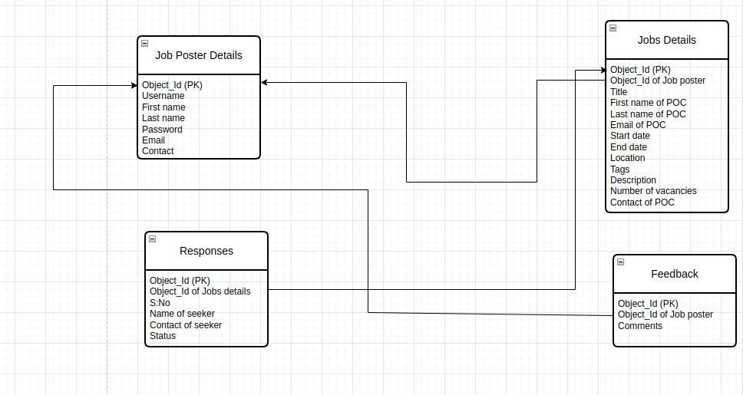
DB Schema

Slide 24
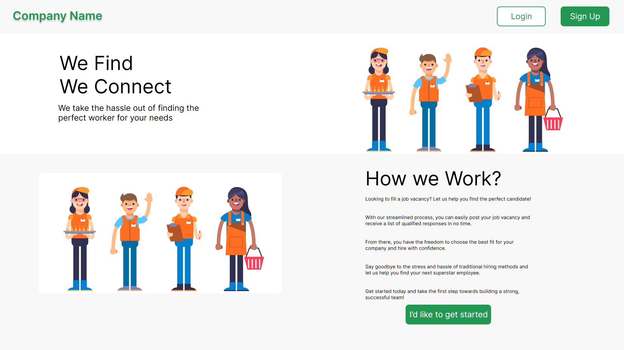
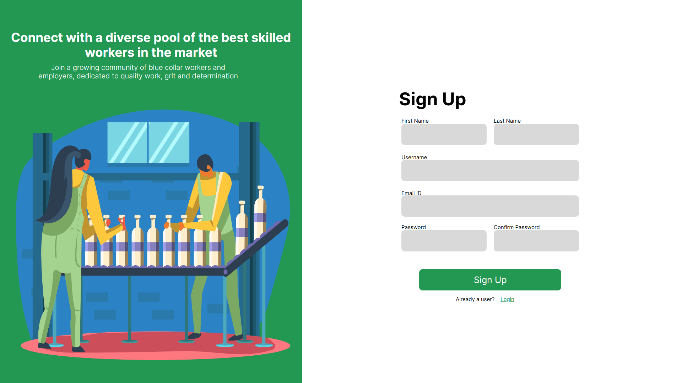
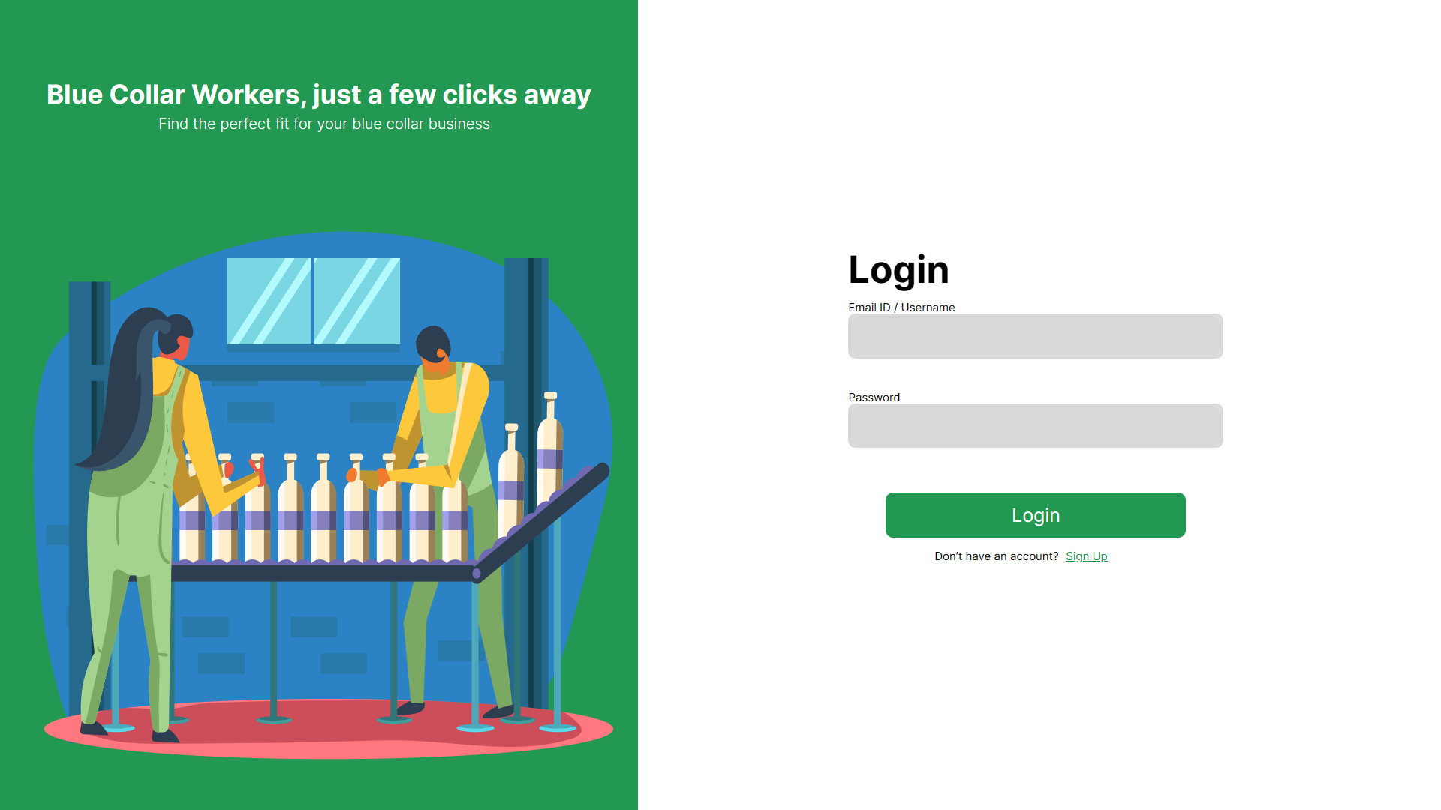
UI Screens

Slide 25
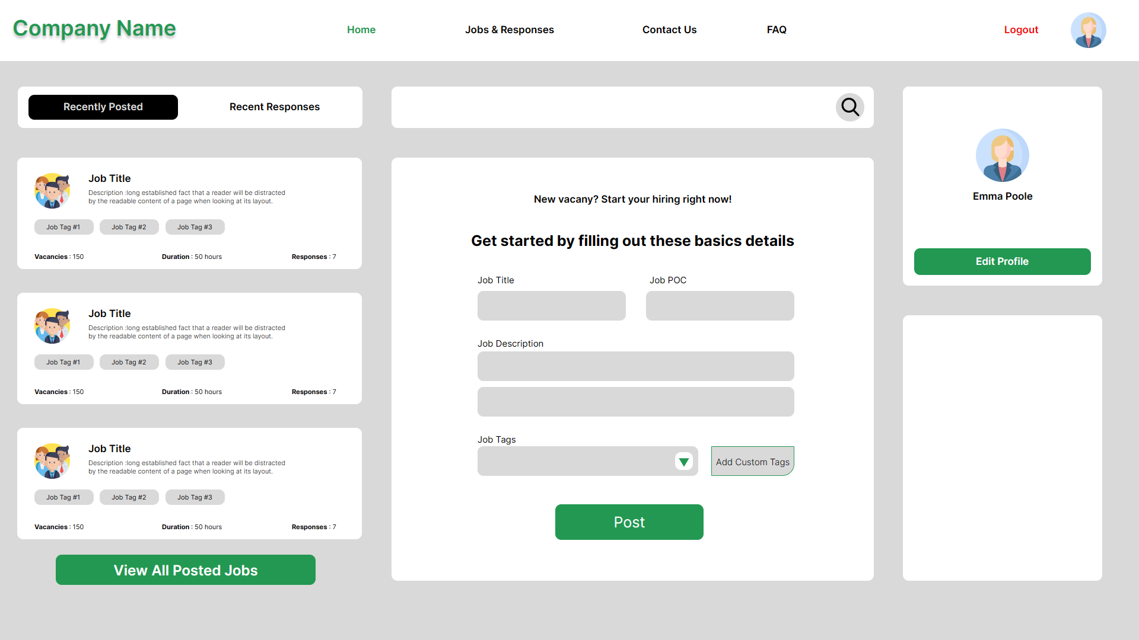
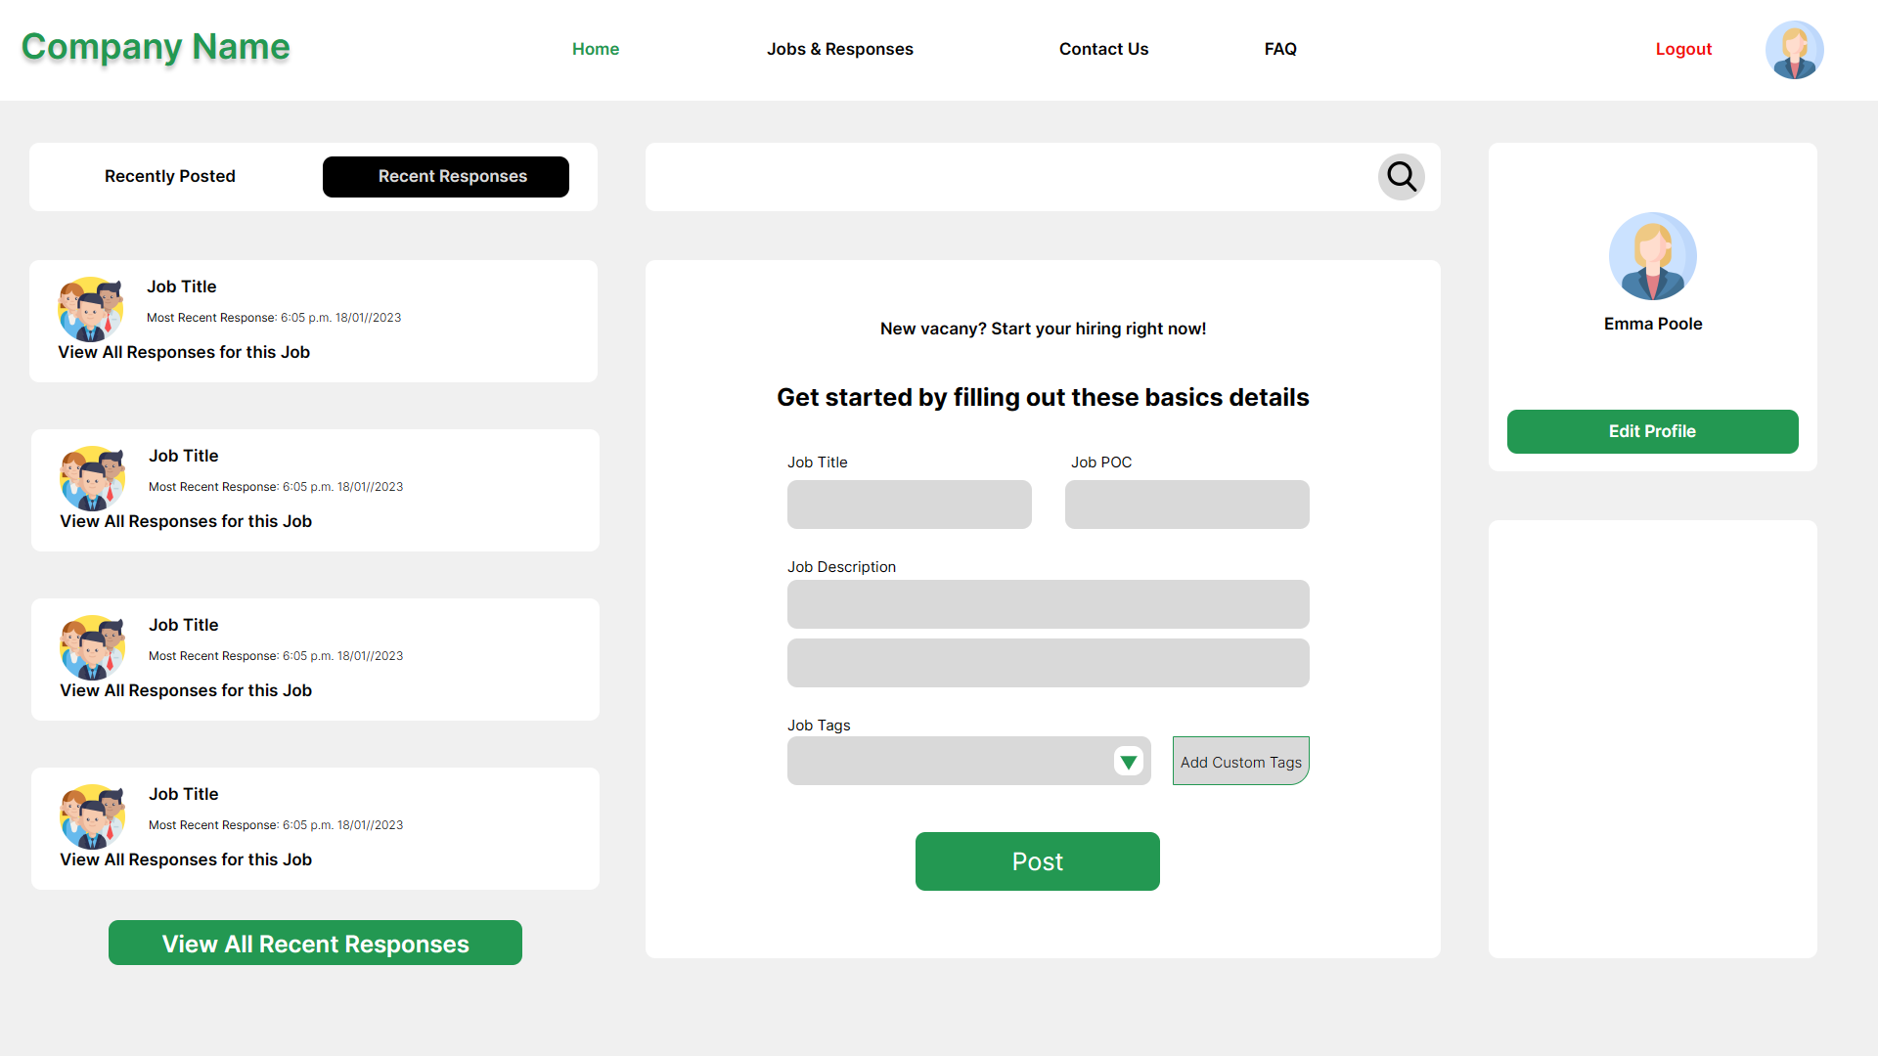
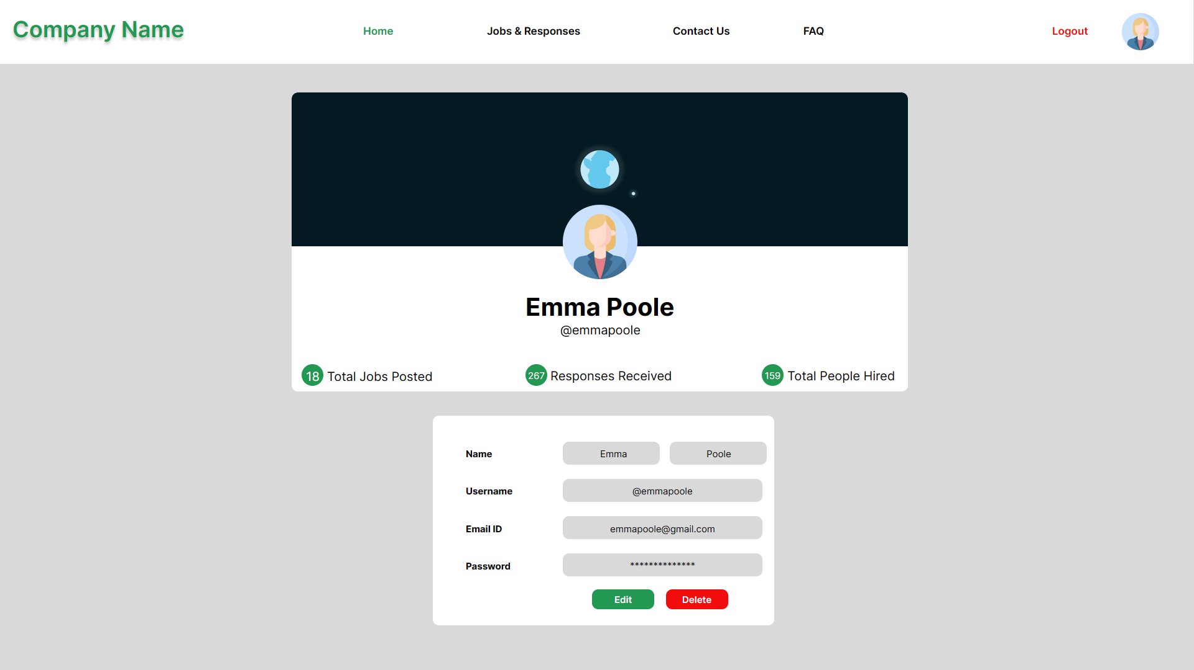
UI Screens

Slide 26
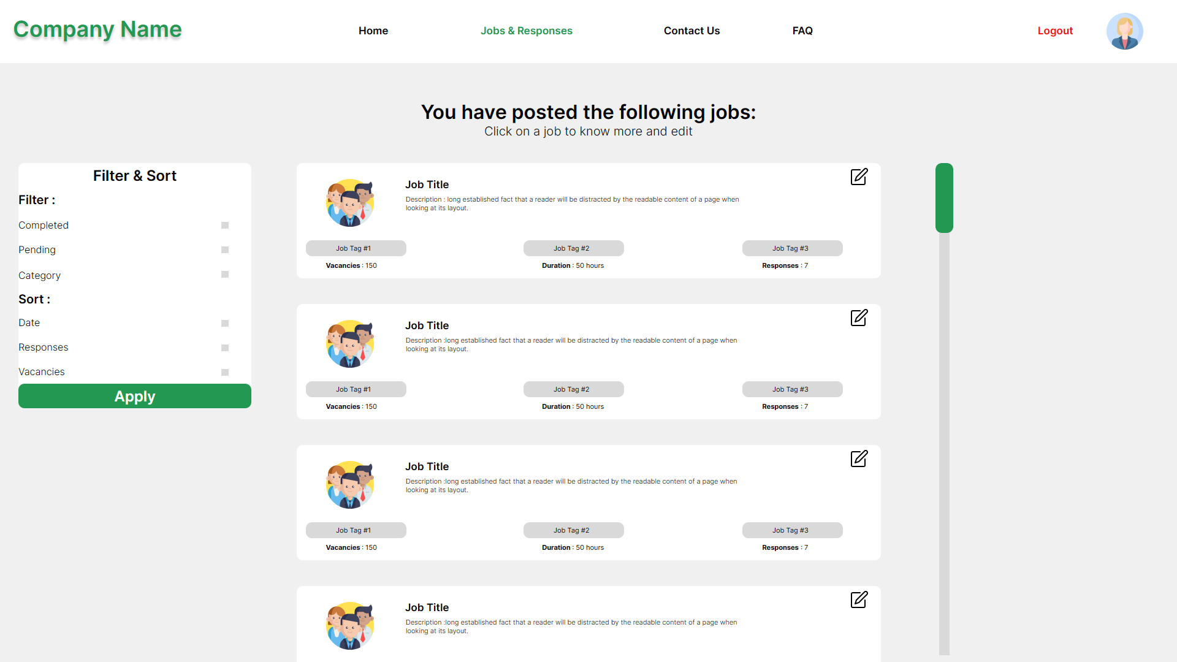
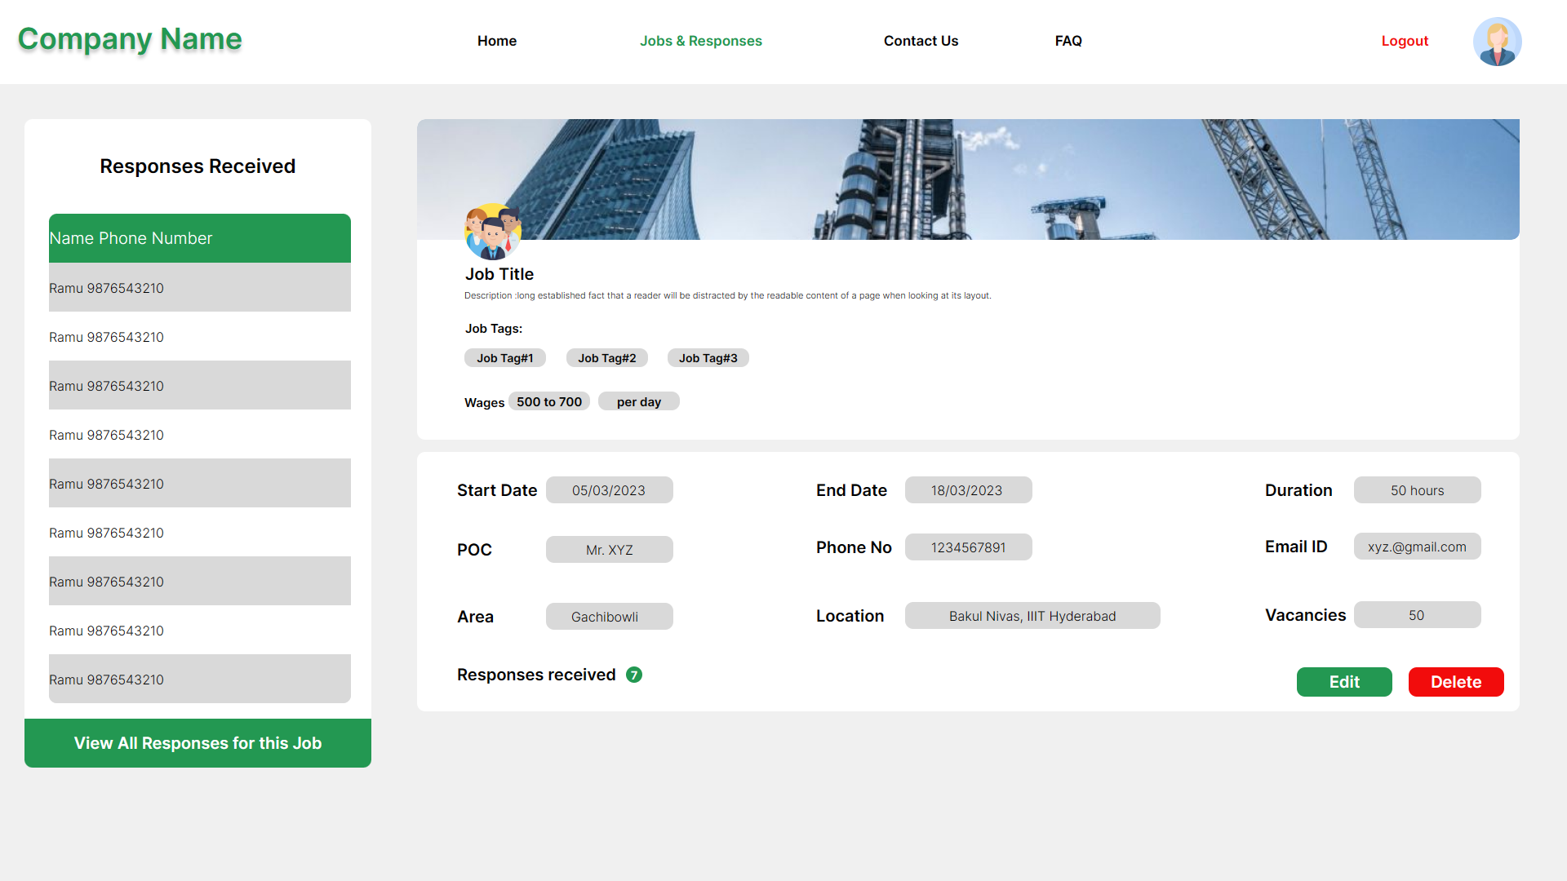
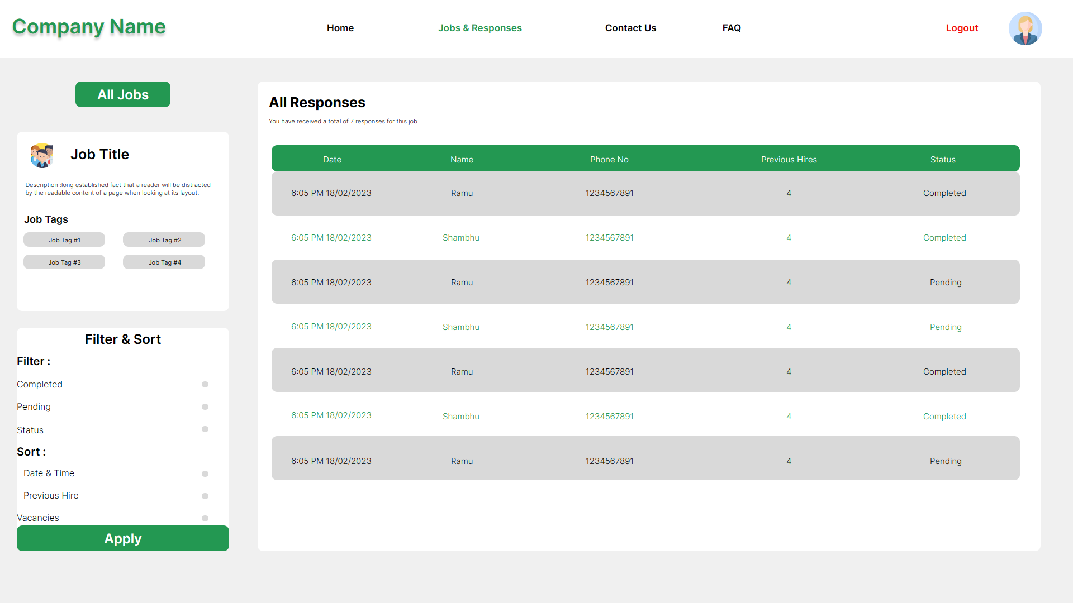
UI Screens

Slide 27
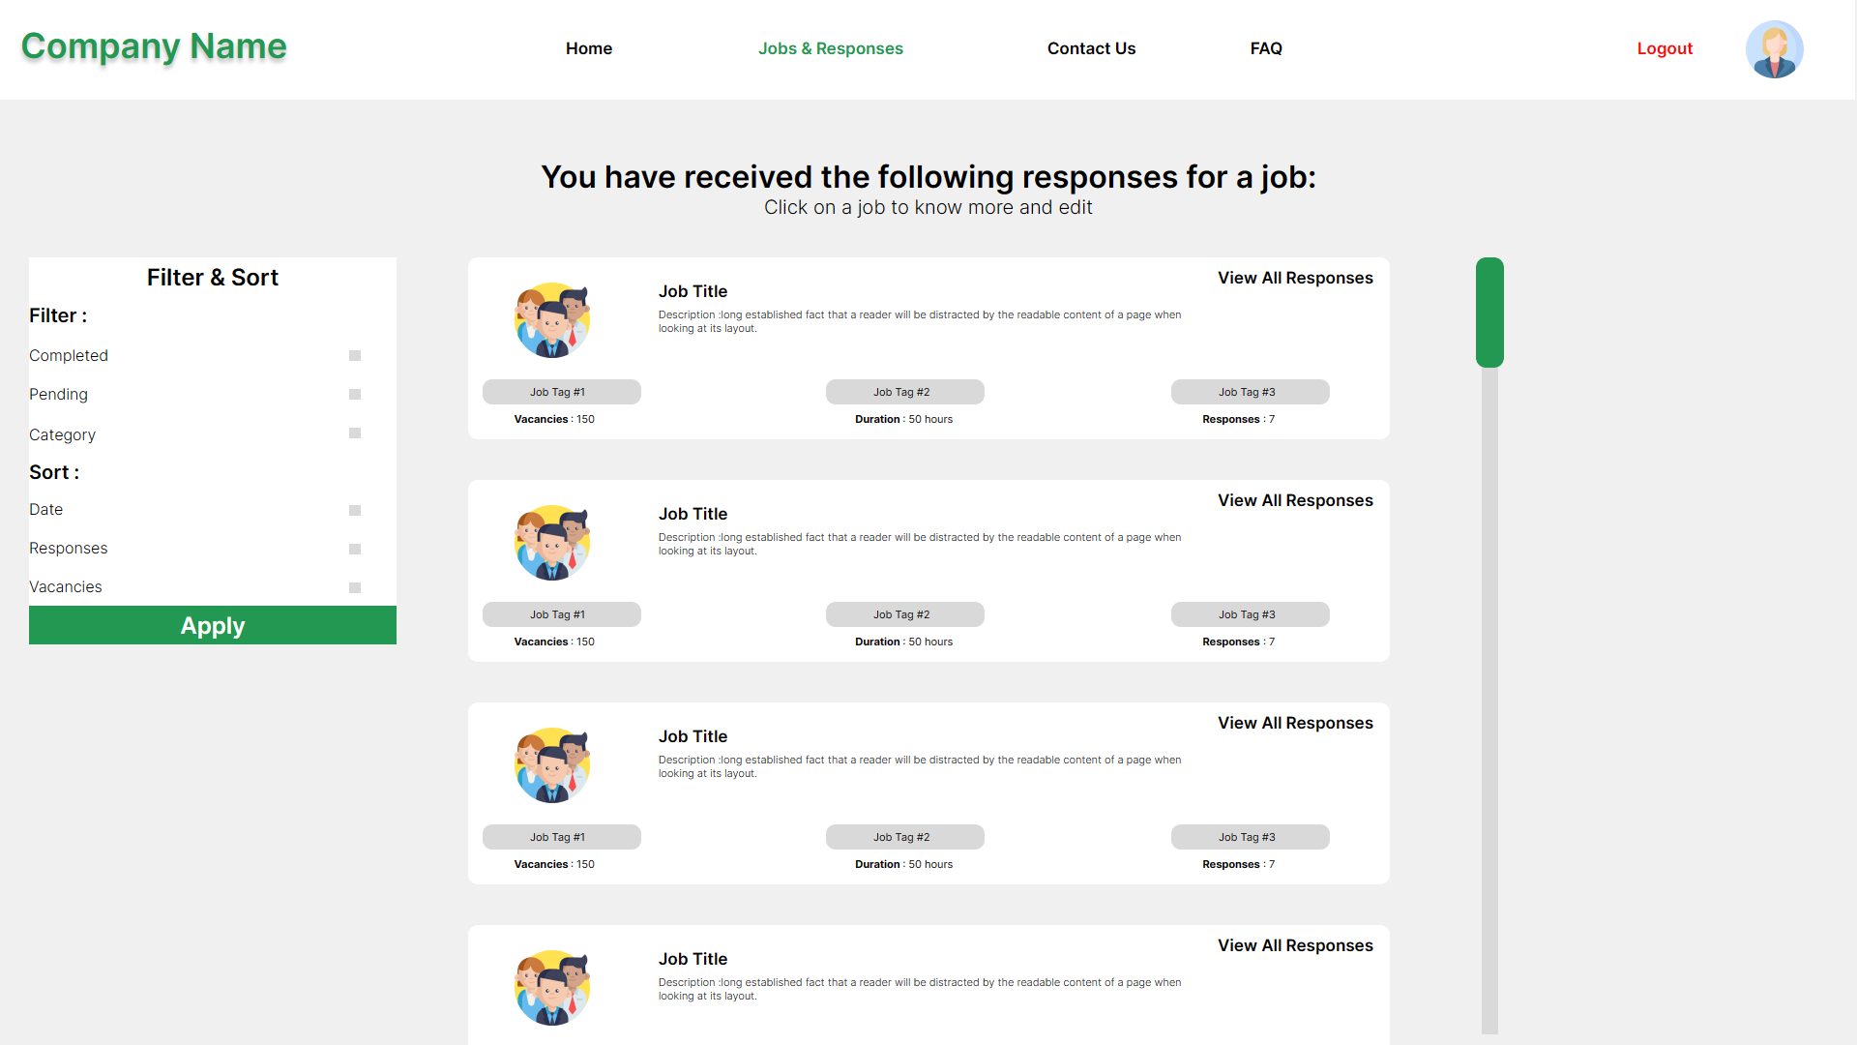
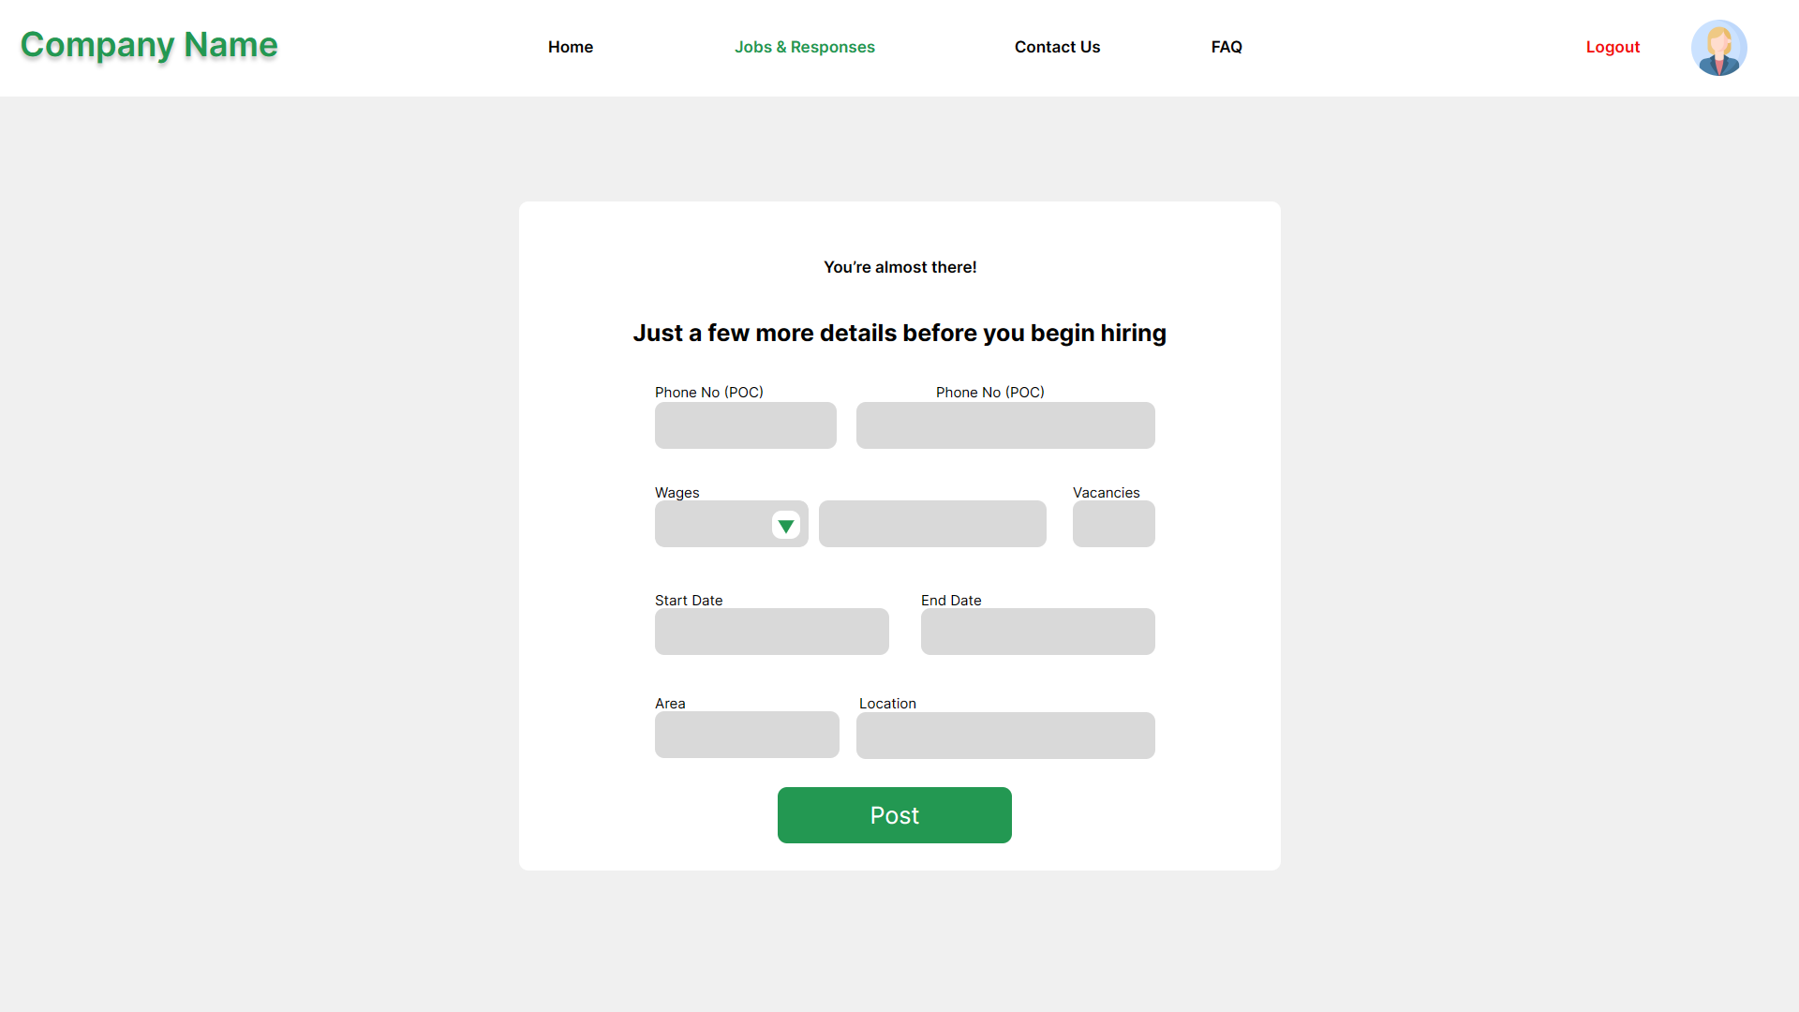
UI Screens

Slide 28
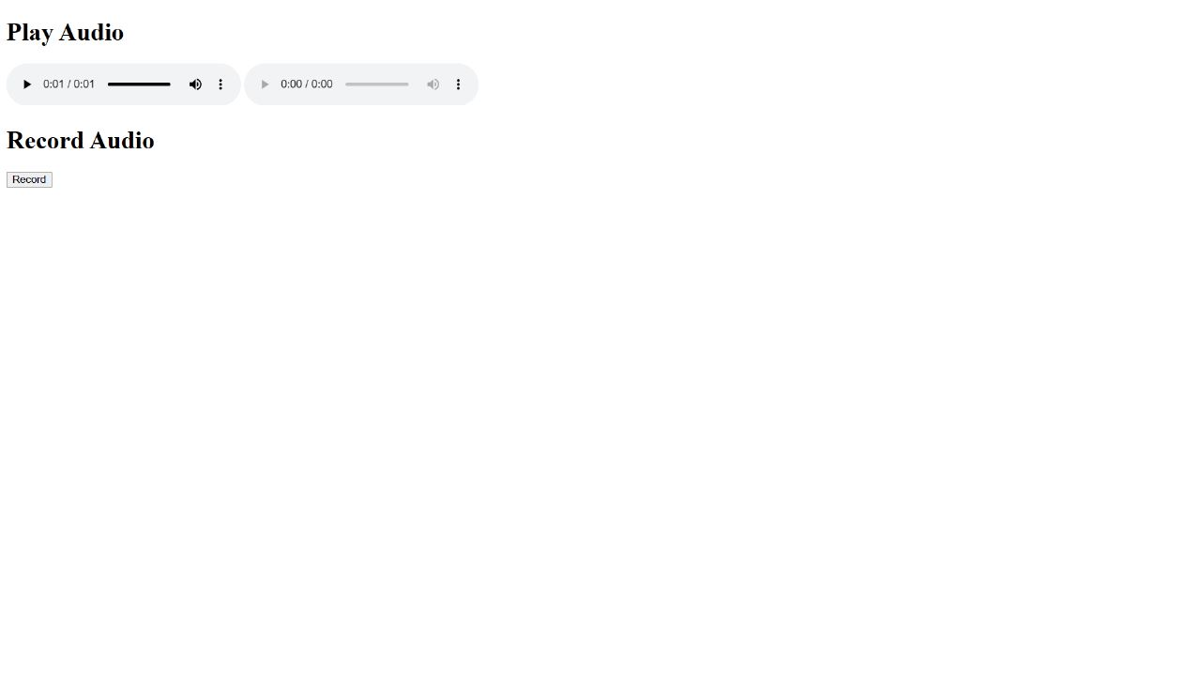
Minimalistic UI app alternative

Slide 29
Project Modules
1. User Management (R1)
a. Job Poster
i. Job Poster Registration
ii. Job Poster Login
iii. Manage account
b. Job Seeker
2. Jobs (R1)
a. Posting new job
b. Manage previously posted job
c. Manage job responses

Slide 30
Project Modules
3. Pipeline (R2)
a. Vernacular Audio Interaction
i. Audio Play Module
ii. Audio Record Module
b. Vernacular - English Translation
c. English - Machine Query Translation
d. Query Processing and Response
i. English to Machine Query Translation
ii. Query Processing
iii. Machine Query Response to English Translation
e. Response Recording
4. Customer Support (R2)
a. Feedback
b. FAQ

